Slide 1

Hotel Booking Cancellation Prediction
MIS 637 - Data Analytics and Machine Learning
Prepared by:
Tejal Rajendra Kuwar
Bhawna
Akshay Vanaparthi
Nithin Reddy Venna
Yashika
Professor:
Prof. Mahmoud Daneshmand

Slide 2
Table of content:
Introduction – Problem statement
Methodology – CRISP-DM
Understanding the Random Forest Algorithm
Performance Comparison
Result Analysis
Conclusion
References

Slide 3
Introduction - Problem statement
Hotels lose revenue when guests cancel late or do not show
Over booking is used to protect revenue but can hurt guest experience if not planned carefully
Our goal – To predict at booking time whether a reservation is likely to be cancelled
With a reliable prediction, the hotel can:
  Choose over booking levels more intelligently
  Focus confirmation efforts on high-risk bookings
  Protect service quality for low-risk bookings

Slide 4
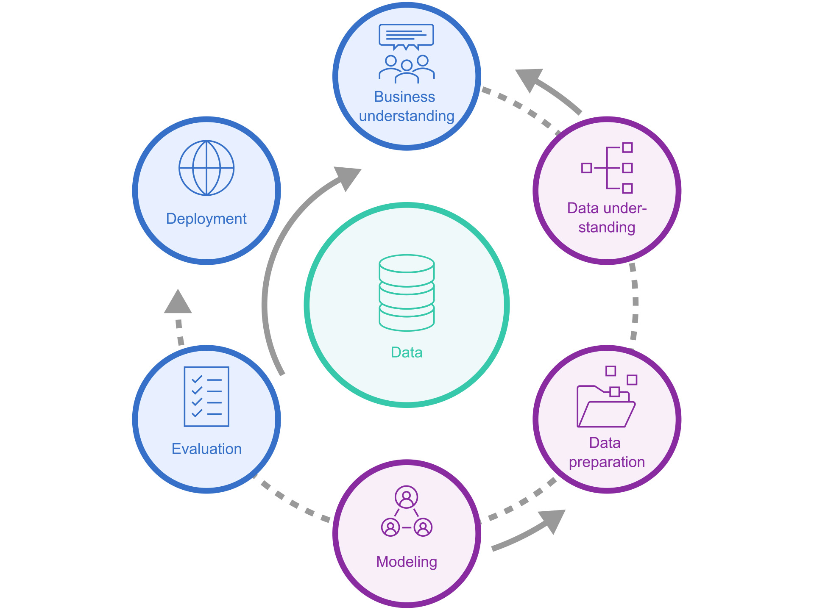
Methodology - CRISP – DM
We followed the standard CRISP DM framework
  Business understanding - Defines the hotel cancellation problem and objectives
  Data understanding - Exploring the hotel bookings data set
  Data preparation - Cleaning data, handling missing values, encoding features and splitting into train and test datasets
  Modelling - Building several predictive models including Random Forest
  Evaluation - Compare models on accuracy, ROC - AUC and inspect confusion matrices
  Deployment - Designing a simple way the hotel could use the final model in its booking system

Slide 5
1. Business Understanding
Why hotel cancellations are a serious problem?
- Cancellations create empty rooms and direct revenue loss
- Last minute cancellations are the most damaging because the room is hard to resell
- Over booking can protect revenue but can also hurt guest experience if too aggressive
- A smart prediction model can help the hotel strike a better balance between revenue and service quality
Our Question
- Can we predict at booking time whether a reservation is likely to cancel ?

Slide 6
2. Data Understanding
Data Source - Hotel Booking Demand data set from Kaggle created by Jesse Mostipak
Scope – 119,390 Reservations combining from a city hotel and a resort hotel
Structure – 32 Variable describing arrival dates, length of stay, number of adults, children and babies, meal plan, country, market segment, distribution channel, customer type, price and booking history
Target Variable - is_canceled = 0 is Reservation not cancelled, is_canceled = 1 is Reservation being cancelled
Class balance - Roughly about one third of all bookings in the data set are cancelled and about two thirds are not cancelled, so the prediction problem has a moderately imbalanced target

Slide 7
Field_Name | Role | Data_Type | Unique_Values | Missing_Percent | Example_Values | Business_Description
hotel | Input | Categorical | 2 | 0 | Resort Hotel; City Hotel | Hotel type (Resort or City)
is_canceled | Target | Numeric (binary) | 2 | 0 | 0; 1 | Whether booking was canceled (1) or not (0)
lead_time | Input | Numeric | 479 | 0 | 342; 737; 7 | Days between booking date and arrival date
arrival_date_year | Input (Date component) | Numeric | 3 | 0 | 2015; 2016; 2017 | Year of arrival date
arrival_date_month | Input (Date component) | Categorical | 12 | 0 | July; August; September | Month name of arrival date
arrival_date_week_number | Input (Date component) | Numeric | 53 | 0 | 27; 28; 29 | Week number of arrival date
arrival_date_day_of_month | Input (Date component) | Numeric | 31 | 0 | 1; 2; 3 | Day of month of arrival date
stays_in_weekend_nights | Input | Numeric | 17 | 0 | 0; 1; 2 | Number of weekend nights (Sat Sun) stayed or booked
stays_in_week_nights | Input | Numeric | 35 | 0 | 0; 1; 2 | Number of week nights (Mon Fri) stayed or booked
adults | Input | Numeric | 14 | 0 | 2; 1; 3 | Number of adults
children | Input | Numeric | 5 | 0 | 0.0; 1.0; 2.0 | Number of children
babies | Input | Numeric | 5 | 0 | 0; 1; 2 | Number of babies
meal | Input | Categorical | 5 | 0 | BB; FB; HB | Type of meal plan booked
country | Input | Categorical | 177 | 0.41 | PRT; GBR; USA | Country of origin of guests
market_segment | Input | Categorical | 8 | 0 | Direct; Corporate; Online TA | Market segment designation such as Online TA or Direct
distribution_channel | Input | Categorical | 5 | 0 | Direct; Corporate; TA/TO | Booking distribution channel
is_repeated_guest | Input | Numeric (binary) | 2 | 0 | 0; 1 | Flag if the guest has previous bookings
previous_cancellations | Input | Numeric | 15 | 0 | 0; 1; 2 | Number of previous canceled bookings by the customer
previous_bookings_not_canceled | Input | Numeric | 73 | 0 | 0; 1; 2 | Number of previous non canceled bookings
reserved_room_type | Input | Categorical | 10 | 0 | C; A; D | Code of the room type reserved
assigned_room_type | Input | Categorical | 12 | 0 | C; A; D | Code of the room type assigned
booking_changes | Input | Numeric | 21 | 0 | 3; 4; 0 | Number of changes made to the booking
deposit_type | Input | Categorical | 3 | 0 | No Deposit; Refundable; Non Refund | Type of deposit paid
agent | Input | Numeric (ID) | 333 | 13.69 | 304.0; 240.0; 303.0 | Identifier of the travel agent that made the booking
company | Input | Numeric (ID) | 352 | 94.31 | 110.0; 113.0; 270.0 | Identifier of the company that made the booking
days_in_waiting_list | Input | Numeric | 128 | 0 | 0; 50; 47 | Number of days the booking was on the waiting list
customer_type | Input | Categorical | 4 | 0 | Transient; Contract; Transient-Party | Category of customer (transient contract group etc.)
adr | Input | Numeric | 8879 | 0 | 0.0; 75.0; 98.0 | Average daily rate price per night per room
required_car_parking_spaces | Input | Numeric | 5 | 0 | 0; 1; 2 | Number of car parking spaces requested
total_of_special_requests | Input | Numeric | 6 | 0 | 0; 1; 3 | Number of special requests made by the customer
reservation_status | Outcome/Leakage (post-booking) | Categorical | 3 | 0 | Check-Out; Canceled; No-Show | Final reservation status (Canceled Check-Out No-Show)
reservation_status_date | Outcome/Leakage (post-booking) | Date (string) | 926 | 0 | 2015-07-01; 2015-07-02; 2015-07-03 | Date of last update of the reservation status
Understanding the dataset before processing
Hotel types: ~66% City Hotel, ~34% Resort Hotel
Target is_canceled: about 37% of bookings are canceled

Slide 8
Sample Data – before processing
hotel | is_canceled | lead_time | arrival_date_year | arrival_date_month | arrival_date_week_number | arrival_date_day_of_month | stays_in_weekend_nights | stays_in_week_nights | adults | children | babies | meal | country | market_segment
Resort Hotel | 0 | 342 | 2015 | July | 27 | 1 | 0 | 0 | 2 | 0 | 0 | BB | PRT | Direct
Resort Hotel | 0 | 737 | 2015 | July | 27 | 1 | 0 | 0 | 2 | 0 | 0 | BB | PRT | Direct
Resort Hotel | 0 | 7 | 2015 | July | 27 | 1 | 0 | 1 | 1 | 0 | 0 | BB | GBR | Direct
Resort Hotel | 0 | 13 | 2015 | July | 27 | 1 | 0 | 1 | 1 | 0 | 0 | BB | GBR | Corporate
Resort Hotel | 0 | 14 | 2015 | July | 27 | 1 | 0 | 2 | 2 | 0 | 0 | BB | GBR | Online TA
Resort Hotel | 0 | 14 | 2015 | July | 27 | 1 | 0 | 2 | 2 | 0 | 0 | BB | GBR | Online TA
Resort Hotel | 0 | 0 | 2015 | July | 27 | 1 | 0 | 2 | 2 | 0 | 0 | BB | PRT | Direct
Resort Hotel | 0 | 9 | 2015 | July | 27 | 1 | 0 | 2 | 2 | 0 | 0 | FB | PRT | Direct
Resort Hotel | 1 | 85 | 2015 | July | 27 | 1 | 0 | 3 | 2 | 0 | 0 | BB | PRT | Online TA
Resort Hotel | 1 | 75 | 2015 | July | 27 | 1 | 0 | 3 | 2 | 0 | 0 | HB | PRT | Offline TA/TO
Resort Hotel | 1 | 23 | 2015 | July | 27 | 1 | 0 | 4 | 2 | 0 | 0 | BB | PRT | Online TA
Resort Hotel | 0 | 35 | 2015 | July | 27 | 1 | 0 | 4 | 2 | 0 | 0 | HB | PRT | Online TA

Slide 9
3. Data Preparation
Removed records with missing target values and any clearly inconsistent bookings after basic checks
Dropped variables that are not available at booking time, for example reservation status and reservation status date, to avoid information leakage into the model
Handled missing values
- For numeric fields such as children we replaced missing entries with zero after checking the distributions
- For categorical fields such as country, agent and company we created a separate category named Unknown
Separated features into numeric and categorical groups so that each could be processed appropriately

Slide 10
3. Data Preparation
Used a column transformer
- Numeric features were scaled using a standard scaler
- Categorical features were converted into dummy variables using one hot encoding
Performed a train test split so that model training happens only on the training set and the test set is kept aside for final evaluation
Applied SMOTE only on the training set to balance the classes by creating synthetic examples for the cancelled bookings while leaving the original test set unchanged

Slide 11
After preprocessing, our final model input has 231 features
Original raw variables were a mix of numeric and categorical fields such as lead time, stay length, booking channel and guest history
Numeric variables were standardized so that they are on a comparable scale
This expansion from a few dozen raw columns to 231 engineered features allows models like Random Forest and the neural network to capture richer patterns and interactions in the data
Feature | Data_Type | Unique_Values | Missing_Count | Missing_Percent | Min | Max | Mean | Std
0 | float64 | 477 | 0 | 0 | -0.9726 | 5.9248 | 0 | 1
1 | float64 | 42 | 0 | 0 | -1.338 | 22.0856 | 0 | 1
2 | float64 | 12 | 0 | 0 | -3.2475 | 84.2297 | 0 | 1
3 | float64 | 5 | 0 | 0 | -0.2606 | 24.8555 | 0 | 1
4 | float64 | 15 | 0 | 0 | -0.1028 | 30.6884 | 0 | 1
5 | float64 | 62 | 0 | 0 | -0.0902 | 48.6131 | 0 | 1
6 | float64 | 20 | 0 | 0 | -0.3388 | 31.881 | 0 | 1
7 | float64 | 122 | 0 | 0 | -0.1319 | 21.911 | 0 | 1
8 | float64 | 7985 | 0 | 0 | -2.115 | 103.4964 | 0 | 1
9 | float64 | 5 | 0 | 0 | -0.255 | 32.2465 | 0 | 1
10 | float64 | 6 | 0 | 0 | -0.7218 | 5.5879 | 0 | 1

Slide 12
Sample Data – after processing, encoding, normalization and class imbalance handled
0 | 1 | 2 | 3 | 4 | 5 | 6
-0.37359 | -0.16686 | 2.001135 | -0.26057 | -0.10276 | -0.09021 | -0.33882
-0.65436 | -0.55726 | 0.251591 | 2.251039 | -0.10276 | -0.09021 | -0.33882
-0.89768 | -0.55726 | 0.251591 | 4.762648 | -0.10276 | -0.09021 | -0.33882
1.376493 | 1.004317 | 0.251591 | -0.26057 | -0.10276 | -0.09021 | -0.33882
-0.7573 | -0.55726 | 0.251591 | -0.26057 | -0.10276 | -0.09021 | -0.33882
0.281519 | 0.613924 | 0.251591 | -0.26057 | -0.10276 | -0.09021 | -0.33882
-0.85089 | -0.55726 | 0.251591 | -0.26057 | -0.10276 | -0.09021 | -0.33882
0.178572 | -0.16686 | 0.251591 | -0.26057 | -0.10276 | -0.09021 | -0.33882
-0.5982 | 0.22353 | 0.251591 | -0.26057 | -0.10276 | -0.09021 | -0.33882
-0.89768 | -0.16686 | 0.251591 | -0.26057 | -0.10276 | -0.09021 | -0.33882
-0.9632 | -0.94765 | -1.49795 | -0.26057 | -0.10276 | -0.09021 | 1.195461

Slide 13
4. Modelling
Goal of modelling stage
Learn a function that takes booking features as input and outputs the probability that the booking will be cancelled
We trained several supervised classification models on the prepared data
- Logistic regression as a simple linear baseline model
- Single decision tree models using C A R T and C 4.5 style splitting rules for transparent if then decision paths
- K nearest neighbour classifier as a distance-based method
- Random Forest classifier which combines many decision trees
- Multilayer perceptron neural network as a nonlinear parametric model

Slide 14
5. Evaluation
Business focus
- We focus mainly on detecting cancellations because missed cancellations lead to empty rooms and loss of revenue.
- At the same time, we must avoid too many false alarms, as this would cause unnecessary overbooking actions and operational confusion.
Main metrics used
- We evaluated all models using accuracy, ROC AUC, precision, recall, and F1-score.
- Special attention was given to recall for the cancellation class to understand how well each model captures high-risk bookings.

Slide 15
5. Evaluation
Summary of model behavior
- Logistic Regression and single decision trees provided reasonable baselines but showed lower recall for cancellations.
- KNN and C 4.5 improved performance slightly but were still limited in handling complex booking patterns.
Final results
- Random Forest performed the best overall, with accuracy in the mid-eighties, ROC AUC near 0.94, and recall for cancellations in the low eighties, making it the most reliable and stable model for predicting hotel booking cancellations.

Slide 16
Understanding the Random Forest Algorithm
Ensemble Learning Power
Mitigating Overfitting:
Random Forest is an ensemble learning method that builds multiple decision trees during training and merges them to get a more accurate and stable prediction. Each tree is unique, trained on different subsets of the data.
By combining predictions from numerous trees, Random Forest significantly reduces the risk of overfitting, a common problem with single decision trees, ensuring better generalisation to unseen data.
Feature Importance
It inherently provides a measure of feature importance, indicating which booking characteristics (e.g., booking lead time, room type, special requests) are most influential in predicting cancellations.
This powerful algorithm is ideally suited for complex datasets where multiple factors influence an outcome, much like our hotel booking cancellation challenge.

Slide 17
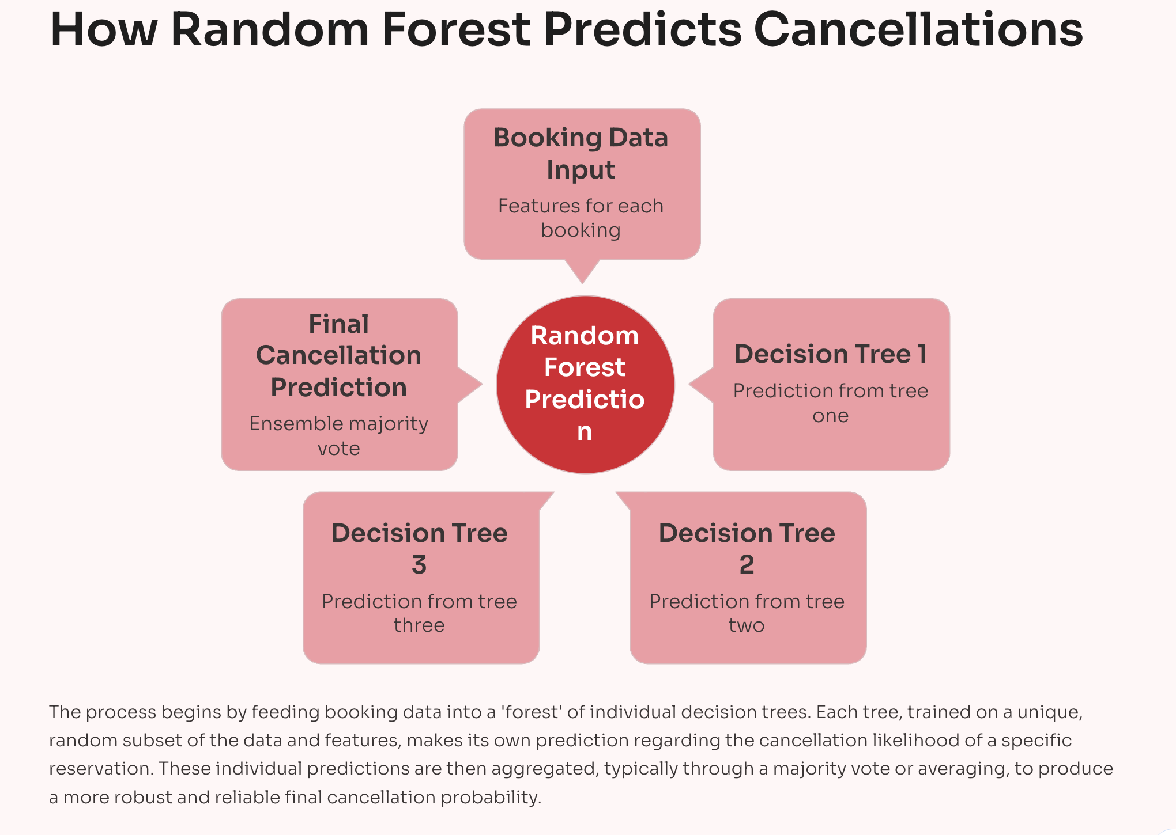

Slide 18
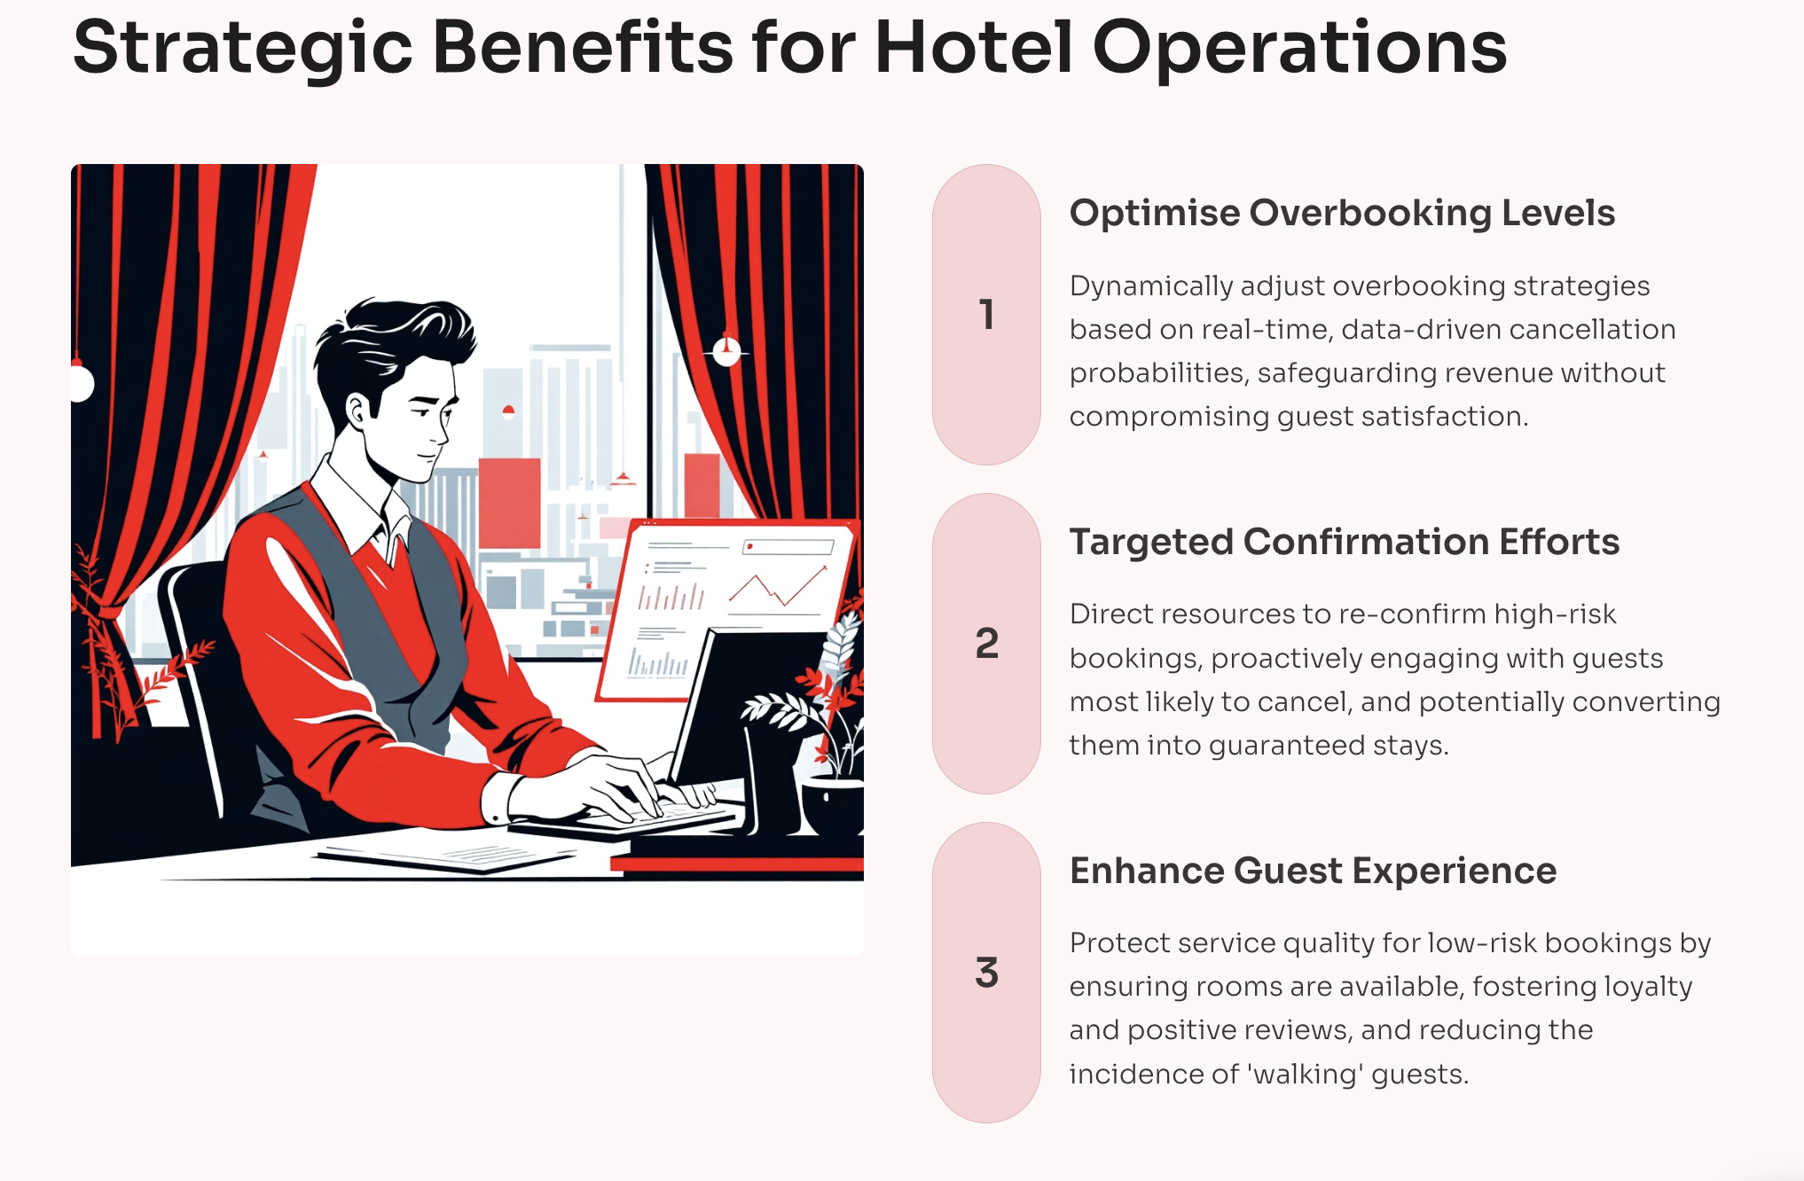

Slide 19
6. Deployment
The final Random Forest model can be wrapped inside a simple service or script that connects to the hotel booking system
When a new booking is created or an existing booking is updated, the system sends the relevant features through the same preprocessing steps used during training
The model returns a predicted probability of cancellation for that booking, along with a simple risk label such as low risk, medium risk or high risk
Revenue managers can use predicted cancellation probabilities to plan over booking levels for each arrival date in a more data driven way

Slide 20
6. Deployment
Reservations staff can focus extra confirmation messages or deposit requests on bookings that the model marks as medium or high risk
Managers can monitor the overall distribution of predicted risk for upcoming dates and adjust pricing and marketing actions if many bookings look risky
The model should be retrained on newer data at regular intervals, for example once per year or when booking patterns change, to keep performance stable and relevant

Slide 21
Performance Comparison
Model | Accuracy | ROC_AUC | Macro_Precision | Macro_Recall | Macro_F1
Random Forest | 0.862 | 0.939 | 0.85 | 0.85 | 0.85
MLP | 0.852 | 0.934 | 0.84 | 0.85 | 0.84
KNN | 0.842 | 0.933 | 0.83 | 0.85 | 0.84
C 4.5 | 0.841 | 0.921 | 0.83 | 0.84 | 0.83
CART | 0.841 | 0.920 | 0.83 | 0.83 | 0.83
Logistic Regression | 0.808 | 0.893 | 0.80 | 0.81 | 0.80

Slide 22
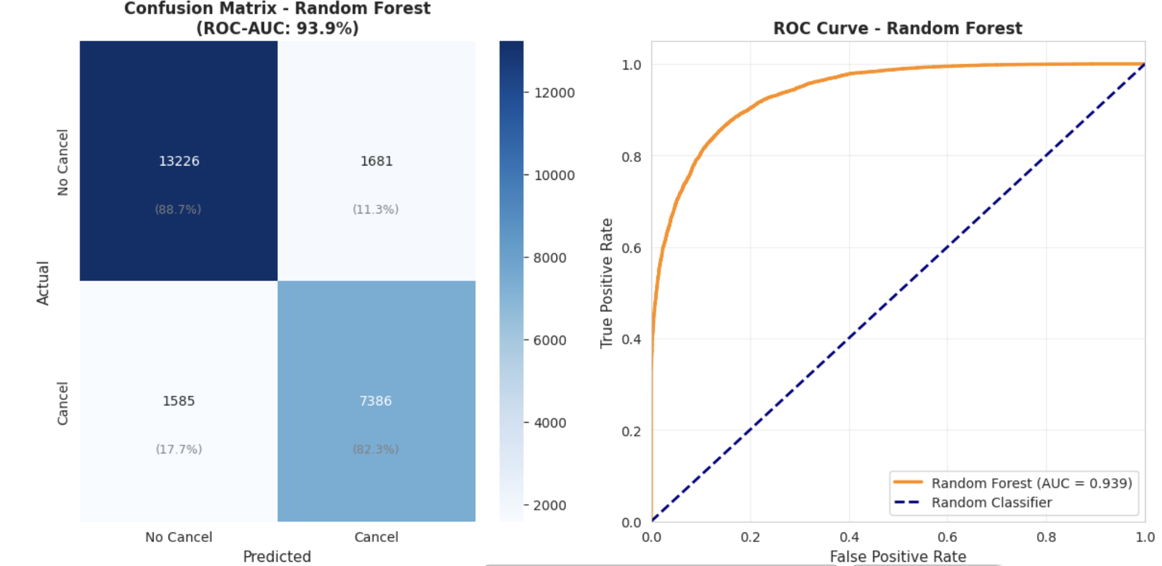
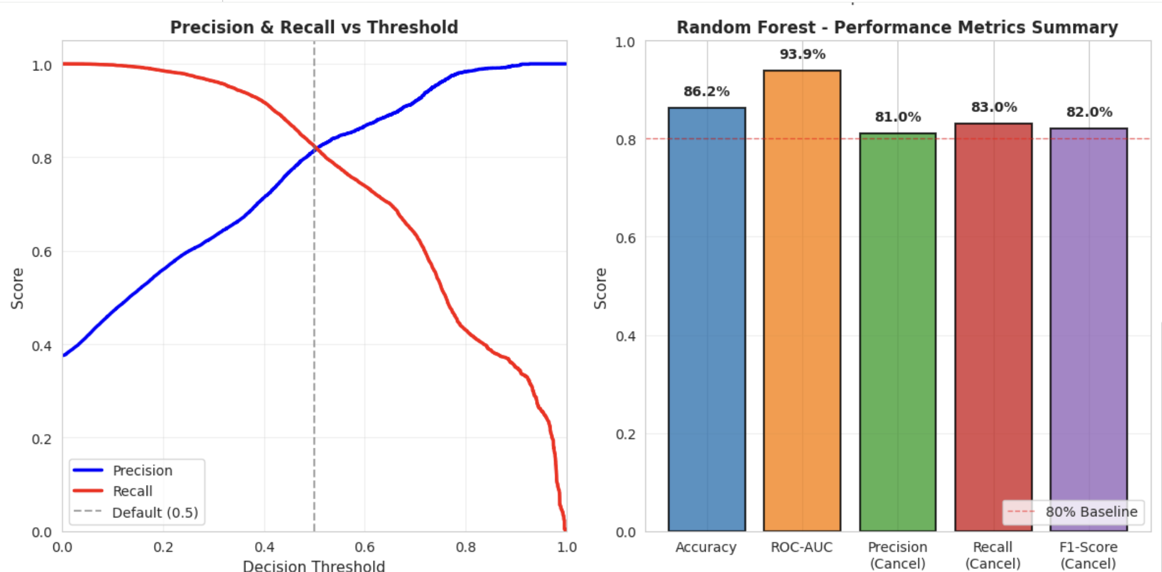
Result Analysis
Confusion Matrix:
- Correctly predicted 13,184 non-cancellations (88% accuracy)
- Correctly predicted 7,402 cancellations (83% recall)
- Only 1,569 false negatives (missed cancellations)
- Only 1,723 false positives (false alarms)
ROC Curve:
- AUC of 93.9% indicates excellent discrimination ability
- Model significantly outperforms random classifier
- Strong separation between cancellation classes
Precision-Recall Trade-Off:
- Default threshold (0.5) balances precision and recall
- Can adjust threshold based on business costs
- Higher threshold → fewer false positives, more false negatives
Metrics Summary:
- All metrics exceed 80% threshold
- Balanced performance across accuracy, precision, and recall
- Model ready for production deployment

Slide 23
Result Analysis
After testing all models, Random Forest gave the best overall performance with an accuracy of 86% and a ROC-AUC of 93.9%. This shows that the model can separate canceled and non-canceled bookings very well.
When we look at the confusion matrix, we see that the model correctly identifies most of the canceledbookings (83% recall). Only a small number of cancellations were missed. This makes the model reliablefor predicting customers who are likely to cancel.
Comparing Random Forest with the other models in the project, it consistently performed better in accuracy, recall,and F1-score. Based on these results, Random Forest is the best model to use for hotel cancellation prediction.

Slide 24
Conclusion
We analyzed hotel booking data and tested multiple machine learning models to predict cancellations effectively.
Among all the models, Random Forest performed the best, achieving high accuracy (86%) and strong recall for canceled bookings (83%), making it reliable for real-world use.
The model helps hotels understand cancellation patterns and make better decisions about overbooking, customer follow-ups, and resource planning.
Using this prediction system, hotels can reduce revenue loss, improve guest experience, and manage reservations more efficiently.
The project also showed that proper data preparation such as handling imbalance and creating meaningful features greatly improves model performance and leads to more accurate predictions.

Slide 25
References
Antonio, N., de Almeida, A., & Nunes, L. (2019). Hotel booking demand datasets. Kaggle.https://www.kaggle.com/datasets/jessemostipak/hotel-booking-demand
Pedregosa, F. et al. (2011). Scikit-learn: Machine Learning in Python. Journal of Machine Learning Research. https://scikit-learn.org/stable/
Chawla, N. V., Bowyer, K. W., Hall, L. O., & Kegelmeyer, W. P. (2002). SMOTE: Synthetic Minority Over-sampling Technique. Journal of Artificial Intelligence Research.
Breiman, L. (2001). Random Forests. Machine Learning, 45(1), 5–32.
Han, J., Kamber, M., & Pei, J. (2012). Data Mining: Concepts and Techniques. Morgan Kaufmann.

